Slide 1

Airlines Reservation System
Harish Singh Bisht
00221102010
Geetanjali
01121102010

Slide 2
Features of our project
User friendly
Easy to operate
database system for all sizes of airlines
Make the reservation and ticketing easier
Reducing the time
Reducing the paper work
Easy to searching the information about flights

Slide 3
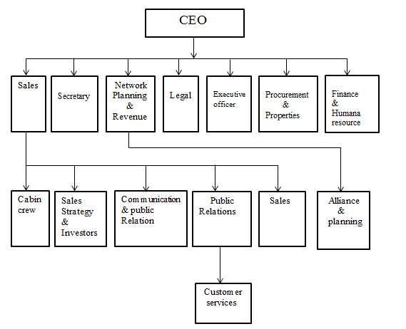
Organisational structure of Jet Airways

Slide 4
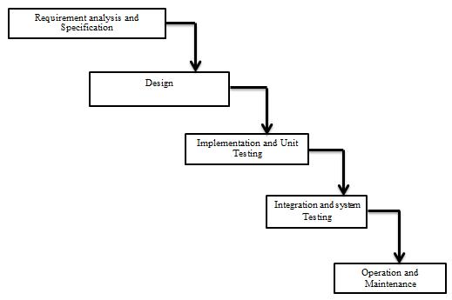
Proposed Methodology or Technique of Project Design(Waterfall Model)
The model which we have used for the development of our project is “WATERFALL MODEL” It is the simplest and most basic approach used to develop software wherein each phase has a well-defined starting and end point. No backtracking is permissible under this approach

Slide 5
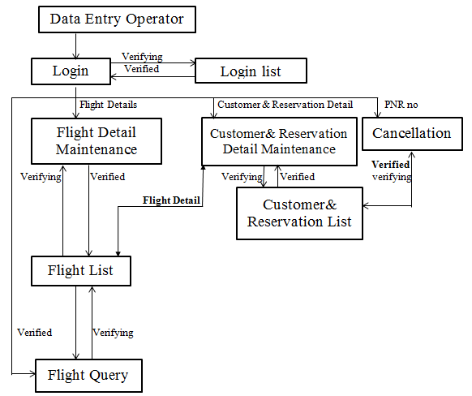
Block diagram of information system

Slide 6
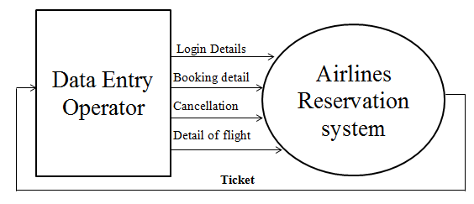
Zero level DFD of Ticket Booking

Slide 7
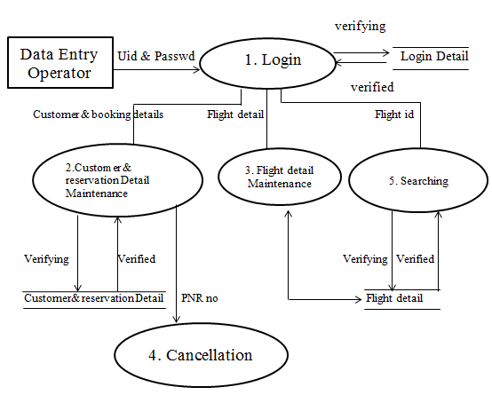
First level DFD of ticket booking

Slide 8
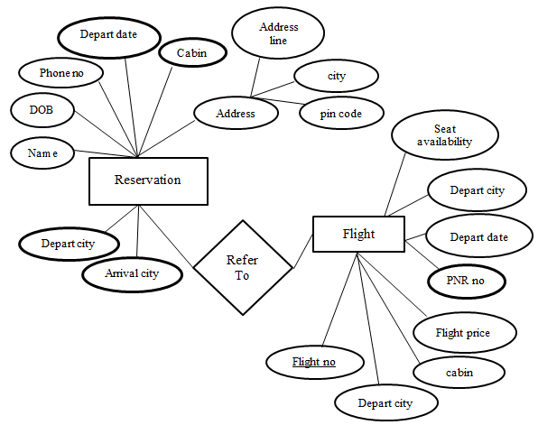
ER DIAGRAM FOR FOR booking ticket

Slide 9
Customer Database
CUSTOMER & RESERVATION DATABASE
Field Name | Field Type | Field Size(No of Character) | Description
Title | Varchar | 4 | Title of customer
First_Name | Varchar | 20 | First Name of the Ticket for whom its booked
Last_Name | Varchar | 20 | Last Name of the Ticket for whom its booked
Date_of_Birth_Day | Number | 2 | Age of passenger according to day
Date_of_Birth_Month | Char | 4 | Age of passenger according to month
Date_of_Birth_Year | Number | 4 | Age of passenger according to year
Mobile_No | Char | 15 | Contact number/ mobile number of passenger
Address_Line_One | Varchar | 50 | Address of passenger
Address_Line_Two | Varchar | 50 | Sub address of passenger
City | Varchar | 10 | City where passenger living
State | Varchar | 15 | State where passenger living
Country | Varchar | 15 | Country where passenger living
Pincode | Char | 8 | Area code of the passengers residential
Pnr_No | Varchar | 20 | Pnr no of the ticket registered/ reserved (system generated)
Flight_No | Varchar | 15 | Unique flight no of plane
Cabin | Varchar | 10 | Section in which the seat reserved

Slide 10
Flight Database
FLIGHT DATABASE
Field Name | Field Type |  | Field Size(No of Character) | Description
Flight_Company |  | Varchar | 15 | The name of the flight company it belongs to.
Depart_City |  | Varchar | 10 | The city from where the flight will take off
Arrival_City |  | Varchar | 10 | The city where the flight will land
Depart_Date |  | Varchar | 10 | Date of flight take off
Depart_Hour |  | Number | 3 | Time in hour of flight’s take off time
Depart_Minute |  | Number | 3 | Time in minutes of flight’s take off time
Eco_No_of_Seat |  | Number | 4 | Total economy seats in flight
Eco_Price |  | Varchar | 10 | Price of one economy seat
Bust_No_of_Seat |  | Number | 4 | Total business seats in flight
Bust_Price |  | Varchar | 10 | Price of one business seat
Flight_No |  | Varchar | 15 | Unique flight no system generated

Slide 11
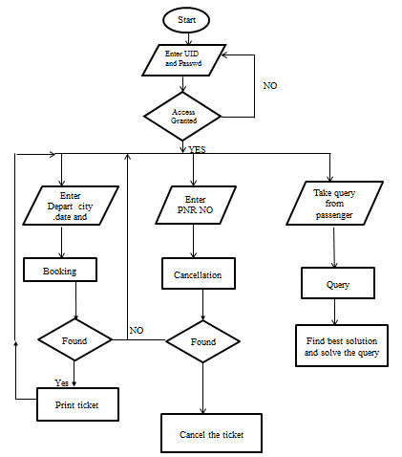
Data Flow Diagram of final program chart

Slide 12
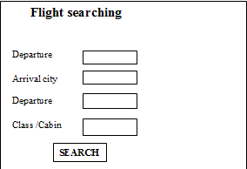
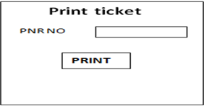
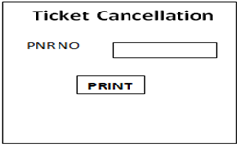
Input Screens
Screen of Flight Searching Screen of Printed ticket
form
Ticket cancellation screen

Slide 13
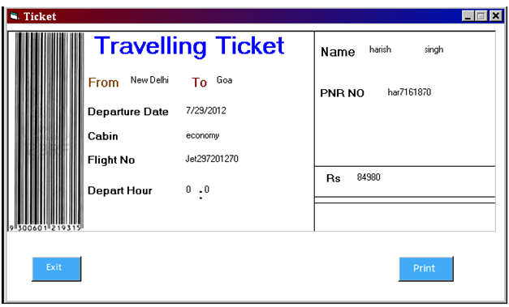
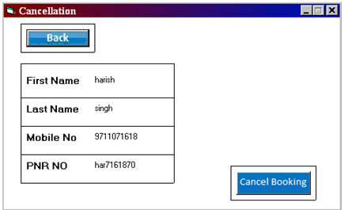
Output screen

Slide 14
Validation checks
a) Passenger’s name cannot be left blank.
b) Passenger’s address cannot be left blank.
c) Passenger’s contact should be there.
d) Passenger’s DOB details cannot be left undone.
e) Amount of seats cannot be left blank
f) Departure place & time cannot be left blank.
g) Only the data entry operator will be authorized to
access the information. Passenger will only be
able to view their transaction history.
h) The total amount can never be negative.

